Slide 1

Linking Data Reduction and Data Analysis with Mantid
Anders Markvardsen
ICANS, Oxford, April 2017

Slide 2
Mantid, reduction and analysis
Methods for linking with Mantid
Examples

Slide 3
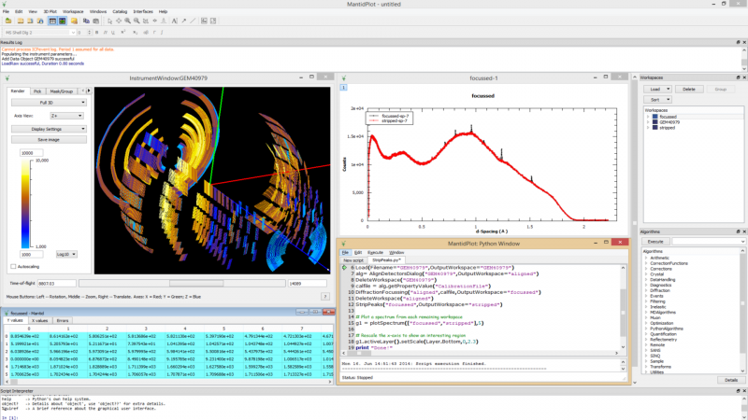
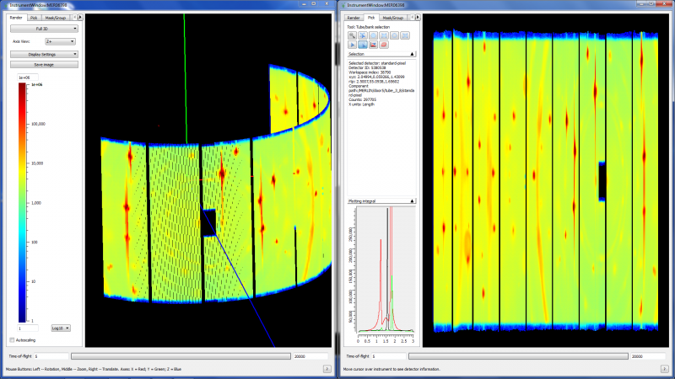




In one slide Mantid
Aims
Data reduction/analysis framework for neutron scattering and muon experiments
Cross-platform
Easily extensible
Freely redistributable
Open source
Adoption
4 Partner Facilities
8 Contributing Organisation
In use on 52 instruments worldwide
Notes:
So Neutron scattering is very powerful, but without software to help understand the results of these large instruments they are worthless

Slide 4
Raw data
Reduced data
Neutron or Muon counts
Meta information
Measurement artefacts removed
Scientific Units
Size: compressed or expanded
Measurement artefacts

Slide 5
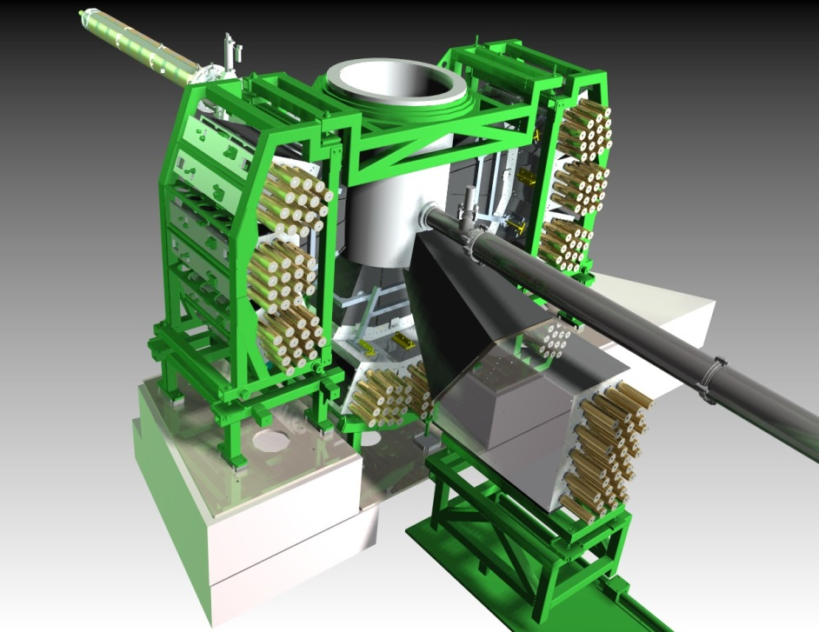
Reduction steps include:
Normalise to data collection time
Remove background
Ignore noisy and dead pixels
Adjust detector positions
TOF ↔ momentum transfer
Focus data (summing spectra)
Tidy up extremes of data
Absorption corrections
Detector efficiency vs wavelength
Incident beam vs wavelength
Notes:
Normalise to data collection time (beam current or monitor counts)
Remove background (stray neutrons in beamline and electronic noise) – empty instrument data set
Masking (ignore noisy or dead pixels)
Focusing and grouping into banks (sum detectors in d-spacing: use calibrated detector positions to convert from tof to d)
Crop (tidy up extremes of data set: no neutrons because chopper closed, or “noisy” data due to low number of counts)
Corrections: vanadium absorption and multiple scattering
Corrections: sample absorption only (and only if sample is absorbing!)
Detector efficiency & incident neutron spectrum both vary (separately) with wavelength – the vanadium data set corrects for both these effects)

Slide 6
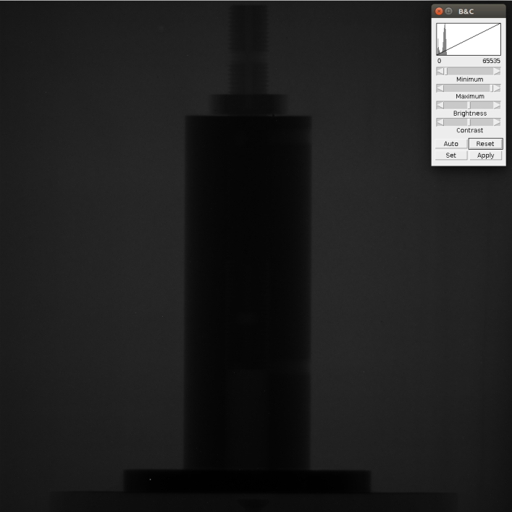
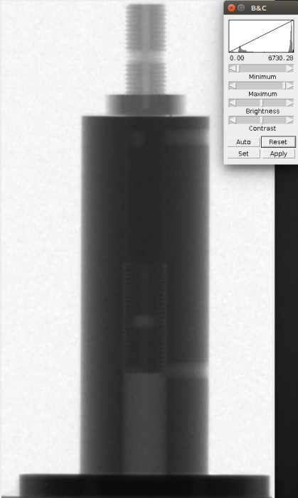
Raw data image
(16 bit TIFF)
Reduced data image
(32 bit TIFF)
Reduction steps may include:
Background noise removed
Crop the region of interest
Mask dark and bright pixels
Filters (Median/Gaussian)
Stripe removal

Slide 7
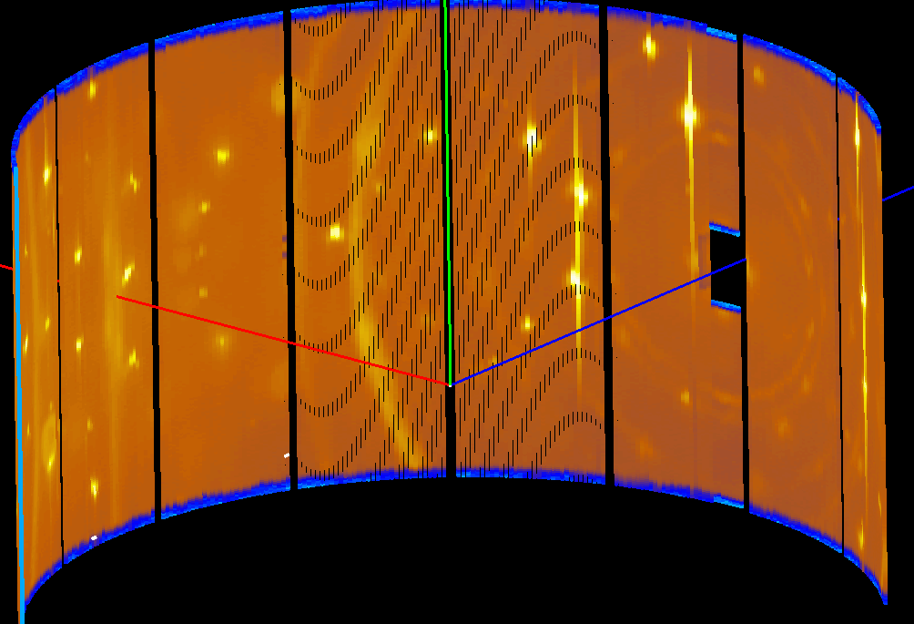
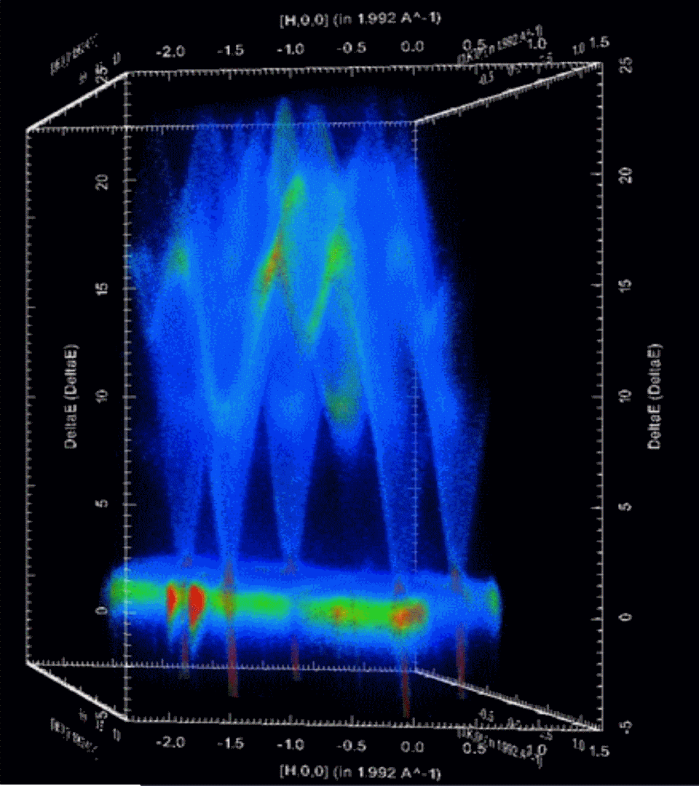
Raw data
Reduced data
Reduction steps include:
Correct for detector efficiencies
Adjust detector positions
Adjust incident energy
TOF ↔ energy and momentum transfer

Slide 8
In summary
What is data reduction?
Anything you do on the raw data before you try to analyse the data

Slide 9
Data analysis examples
Tomographic reconstruction
MuhRec, Tomopy, SAVU, Octopus
Simulation software
CASTEP, CRYSTAL, McStas, nMoldyn
Domain specific fitting software
Sasview, GSAS, Fullprof, FABADA, TobyFit

Slide 10
Methods for linking
By data format
By algorithms
By function
By using Mantid through Python
By the script repository

Slide 11
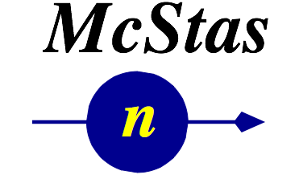
By data format
by CanSAS format
SasView
by event data format
Notes:
Advantages include:
Can revisit later
Persistence
Logic encapsulated in loader/saver
Non expert can use
Save to disk can be made optional

Slide 12
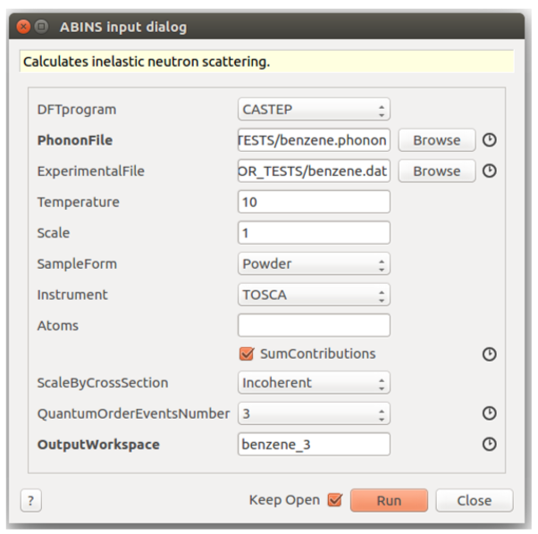
By algorithm
http://docs.mantidproject.org/nightly/algorithms/Abins-v1.html

Slide 13
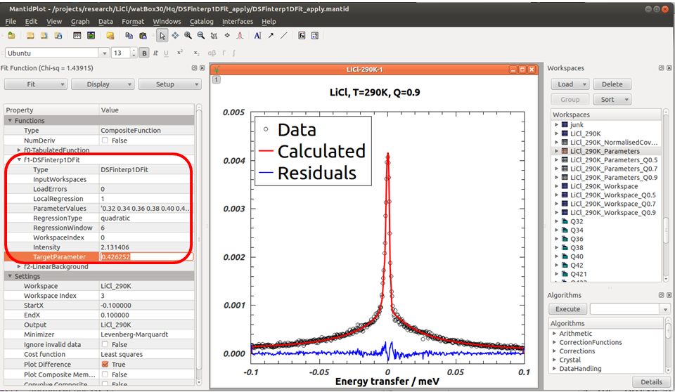
By function
DSFinterp1DFit
A Mantid fitting function to optimize simulated QENS spectra against experiment
Requires external python library dsfinterp (https://pypi.python.org/pypi/dsfinterp/0.1)
Notes:
Modified slide originally from Jose Borreguero

Slide 14
By using Mantid through Python
Import Mantid
Import MyAnalysisSoftware
….

Slide 15
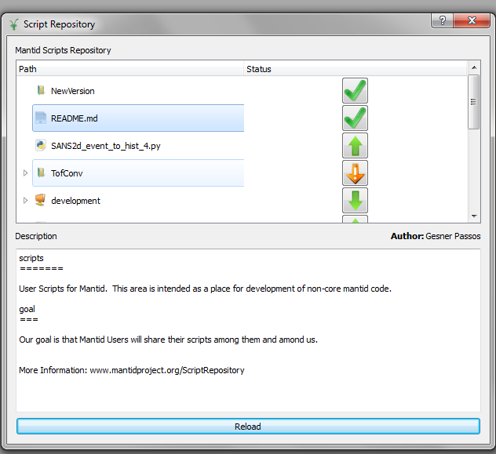
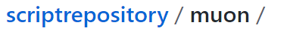
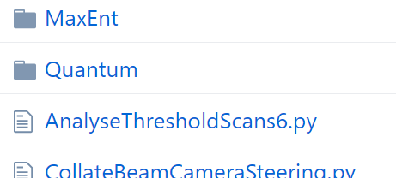
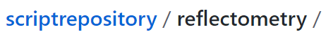
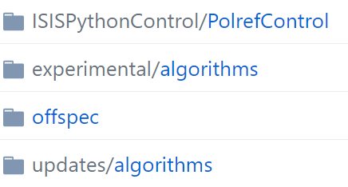
By script repository
Example content:
Notes:
No knowledge of git required
Easy to share scripts
No coding standards & automated tests required

Slide 16
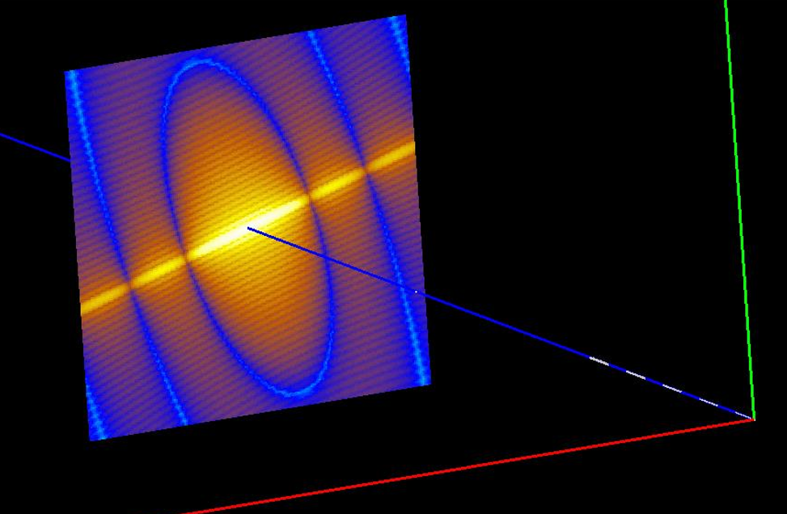
McStas ↔ Mantid
http://docs.mantidproject.org/nightly/algorithms/LoadMcStas-v1.html
Nielsen., T.R. et al., McStas and Mantid integration, J. of Neut. R., 61-77, 2015
Peter Willendrup 16:40 Thursday
Mads Bertelsen 17:05 Thursday
Notes:
Take instrument design one step further
Pre-experiment analysis
Multiple scattering for general geometries?

Slide 17
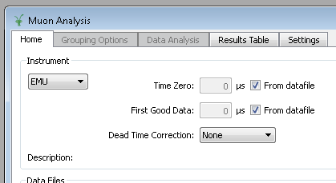
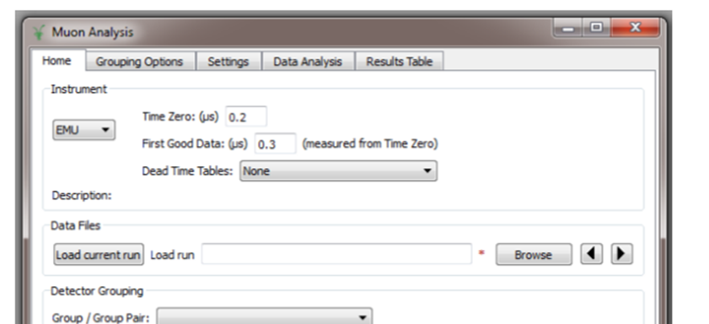
Example of analysis software in Mantid
http://www.isis.stfc.ac.uk/groups/muons/muon-data-analysis-workbook14904.pdf
https://www.e-neutrons.org/

Slide 18
Conclusions
Mantid is designed to be easy to link to and to work with
Also Mantid has:
a well supported fitting engine
and an increasing number of tools for comparing experimental and simulated data

Slide 19







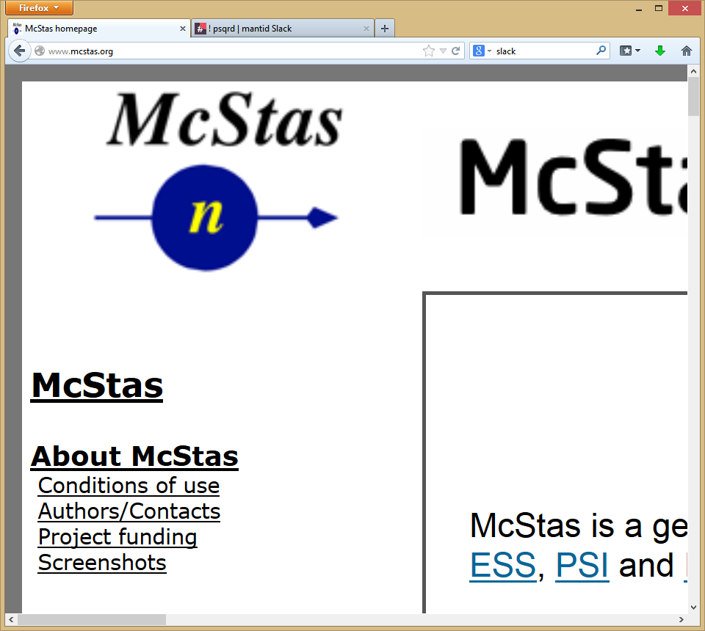

Contributors
Partners
Prime Contractor
Contributors

